Slide 1
Programming Fundamentals
Dr. Abdul Aziz
Assistant Professor & HoD
Department of Software Engineering
NUCES-FAST, Karachi.

Slide 2
Transition Phase
Yearly system to Semester System

Slide 3
Course Content
Building Blocks
Decision Control Structures
Iterative Control Structures
Arrays
Functions
Pointers
Structures

Slide 4
Books
C How to Program by Paul Deitel, Harvey Deitel
Turbo C Programming for the PC by Robert Lafore
Problem Solving and Program Design in C by Maureen Sprankle , Jim Hubbard
Let us C by Yashwant Kanetkar

Slide 5
Assessment Instruments with Weights
Assignment and Quizzes /Class participation 20
Midterm (2 midterms) 30
6th week
11th week
Final 50

Slide 6
Tools
Language: C
IDE: DevC++, Visual Code

Slide 7
What is Programming?
What is a Program ?
What is a Language ? (Computer Language)

Slide 8
Why Programming?

Slide 9
Class 2, Week 1
Problem Solving

Slide 10
Pre-Programming
Step 1: Analyzing the problem.
Step 2: Developing the IPO chart.
Step 3: Writing the algorithm.
Step 4: Drawing the program flowcharts.

Slide 11
Analyzing the problem
Understand the Problem
Analyze the Requirements of the Problem
A good way to analyze a problem is to separate it into four parts, problem analysis chart( PAC) :

Slide 12
Problem Analysis Chart( PAC)
1.The given data.(constant and variables)
2.The required results.(the out put)
3.The processing that is required in the problem .(equations and expressions)
4.A list of solution alternatives .

Slide 13
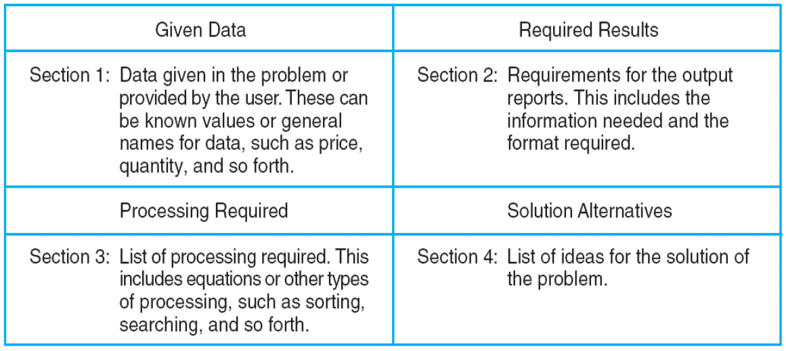
Problem Analysis Chart( PAC)

Slide 14
Example
Calculate the gross pay of an employee. The formula to be used is
GrossPay=Hours*PayRate
Develop PAC for a solution to this problem?

Slide 15
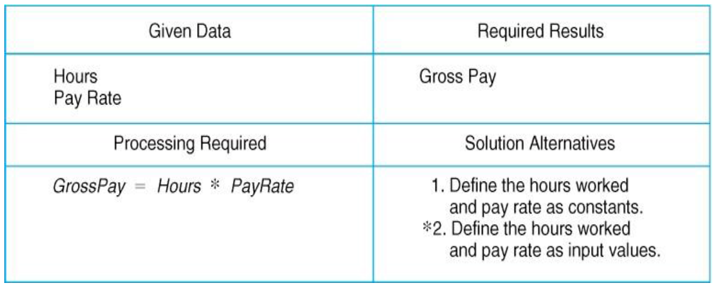
PAC

Slide 16
Developing Input Processing Output (IPO) Chart
IPO chart shows:
What data item are input
What processing takes place on that data
What information will be the end result, the output
Input | Processing | Output
All input data (from Step 1 of PAC) | All processing in steps(3 and 4 of PAC) | All output requirements (step 1 and 2 of PAC)

Slide 17
IPO
Input | Processing | Output
1- Hour worked 2- Rate per hour | 1- Enter/Read hours worked 2- Enter/Read Rate per hour 3- Calculate pay by multiplying hours with rate 4- Print Gross Pay 5- End | Print Gross Pay

Slide 18
Writing the Algorithm
The next step of organizing a solution is to develop sets of instructions for the computer, called algorithms
The programmer writes a separate set of instructions for each module in the structure chart
The number of instruction is determined by the way the programmer chooses to solve the problem
“Step by Step procedure / instructions to perform a specific task”

Slide 19
Drawing the Flowchart
Graphic representations of the algorithms.
The algorithms and flowcharts are the final steps in organizing a solution.
A flowcharts shows the flow of the processing from the beginning to the end of a solution.
Each block in a flowchart represents one instruction from an algorithm.

Slide 20
Class 3, Week 1
Introduction to C

Slide 21
Introduction
C is a general-purpose programming language created by Dennis Ritchie at the Bell Laboratories in 1972.
C is strongly associated with UNIX.
It was developed to write the UNIX operating system.

Slide 22
Requirements
A text editor.
A compiler. GCC “GNU Compiler Collection” OR MinGW
An IDE (Integrated Development Environment) is used to edit AND compile the code.

Slide 23
Steps to write a program
Step 1 : open new file.
Step 2: add Header files #include <stdio.h> #include<conio.h>
Step 3: write program
Step 4: Compile Program
Step 5: Save file with an extension “.c”
Step 6: Run Program
Step 7: Exit

Slide 24
Basic Structure of C program
#include<stdio.h>
#include<conio.h>
void main (void){
WRITE YOUR CODE HERE
}

Slide 25
Output function
Syntax:
printf(“ WRITE ANYTHING HERE TO PRINT ” );
Remember: Every line is terminated by a ;
Example :
printf(“My first program”);

Slide 26
My first Program
#include<stdio.h>
#include<conio.h>
void main (void){
printf(“My first program”);
}
Step 1: Build the program (Compile)
Step 2: Run program (Execute)

Slide 27
Elements of a language
Character Set: Alphabets
Grammar: The rules of language
Sentences: Meaningful element created with the help of Characters and Grammar.

Slide 28
Elements of Computer Language
Character Set
Keywords
Data Types
Syntax

